Slide 1
Declaring the Publication Ethics
(Scopus Comments)
Razieh Moghadam,
Kowsar Corporation,

Slide 2

SciVerse Scopus
Scopus, officially named SciVerse Scopus, is a bibliographic database containing abstracts and citations for academic journal articles. It covers nearly 18,000 titles from over 5,000 international publishers, including coverage of 16,500 peer-reviewed journals in the scientific, technical, medical, and social sciences (including arts and humanities).It is owned by Elsevier and is available online by subscription. Searches in Scopus incorporate searches of scientific web pages through Scirus, another Elsevier product, as well as patent databases.

Slide 3
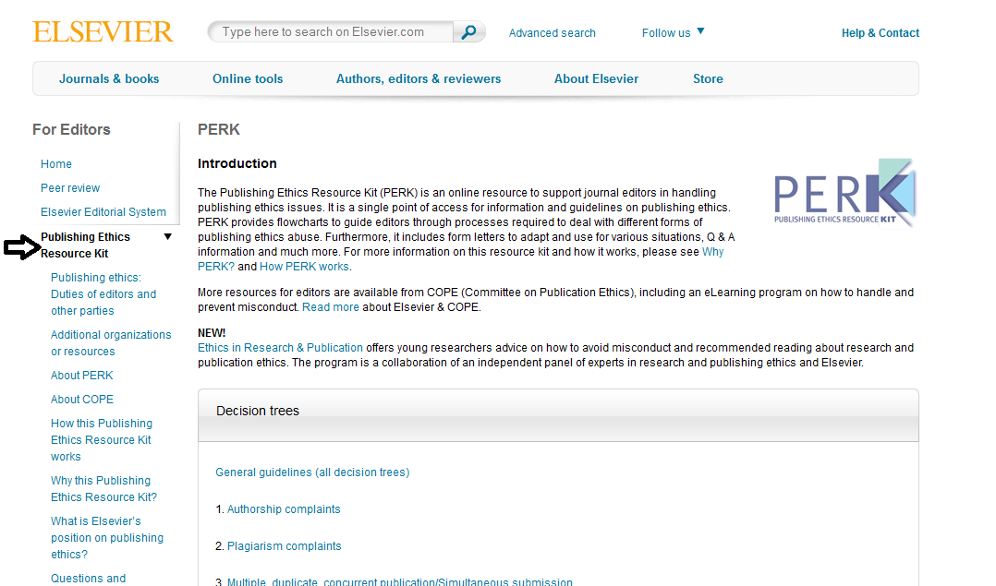
Better to be as the main link in EIC/Authors/Reviewers’ Area
http://www.elsevier.com/editors/home

Slide 4
A publication ethics and malpractice statement has to contain the subjects below:
Publication and authorship
no plagiarism, no fraudulent data;
forbidden to publish same research in more than one journal.
list of references, financial support;
Author's responsibilities
Authors obliged to participate in peer review process
All authors have significantly contributed to the research
Statement that all data in article are real and authentic
All authors are obliged to provide retractions or corrections of mistakes (http://www.elsevier.com/editors/perk/general-guidelines-all-decision-trees)

Slide 5
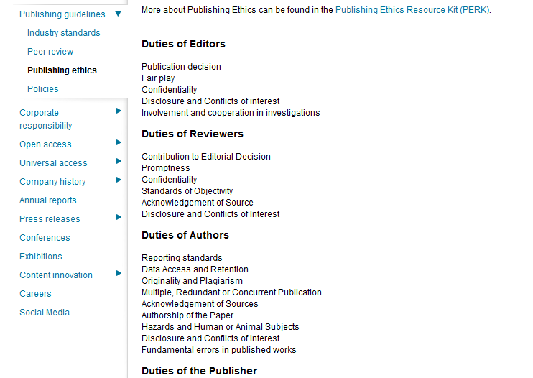
Peer review / responsibility for the reviewers
Judgments should be objective
Reviewers should have no conflict of interest with respect to the research, the authors and/or the research funders
Reviewers should point out relevant published work which is not yet cited
Reviewed articles should be treated confidentially
(http://www.elsevier.com/about/publishing-guidelines/publishing-ethics)

Slide 6
Editorial responsibilities
Editors have complete responsibility and authority to reject/accept an article
Editors should have no conflict of interest with respect to articles they reject/accept
Only accept a paper when reasonably certain
When errors are found, promote publication of correction or retraction
Preserve anonymity of reviewers
(http://www.elsevier.com/about/publishing-guidelines/publishing-ethics)

Slide 7
Publishing ethics issues
Monitoring/safeguarding publishing ethics by editorial board
Guidelines for retracting articles (http://www.nature.com/authors/policies/corrections.html)
Maintain the integrity of the academic record
Preclude business needs from compromising intellectual and ethical standards
Always be willing to publish corrections, clarifications, retractions and apologies when needed
no plagiarism, no fraudulent data
http://www.elsevier.com/editors/perk

Slide 8
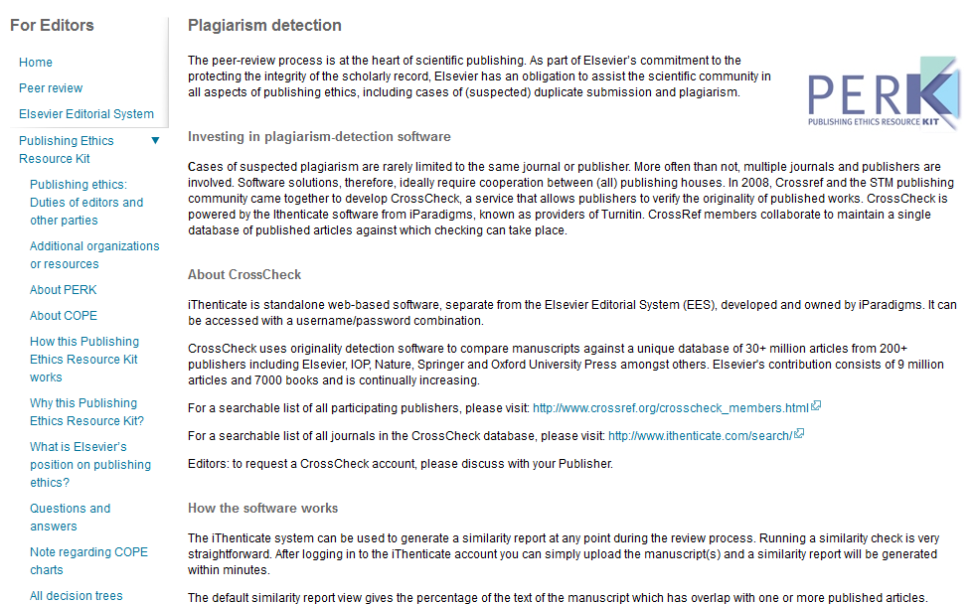
Other Subjects Which Can be Declared
Plagiarism Detection
http://www.elsevier.com/editors/perk/plagiarism-detection

Slide 9
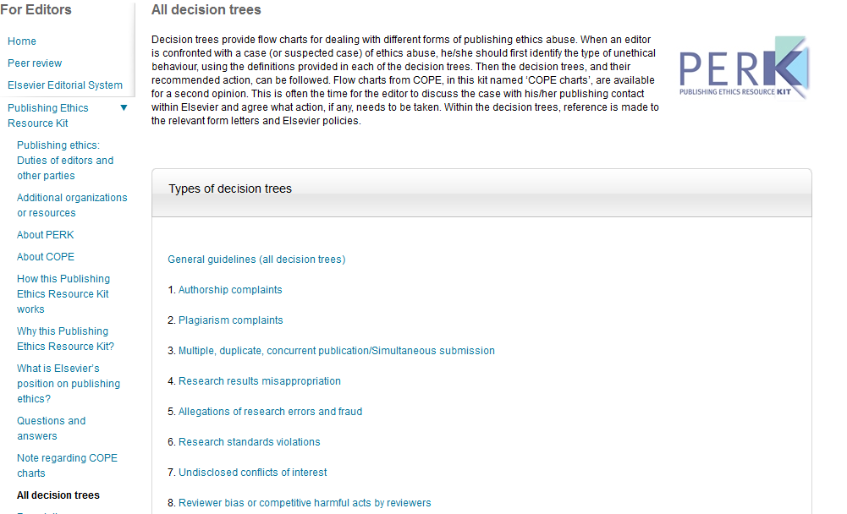
All Decision Trees
http://www.elsevier.com/editors/perk/all-decision-trees

Slide 10
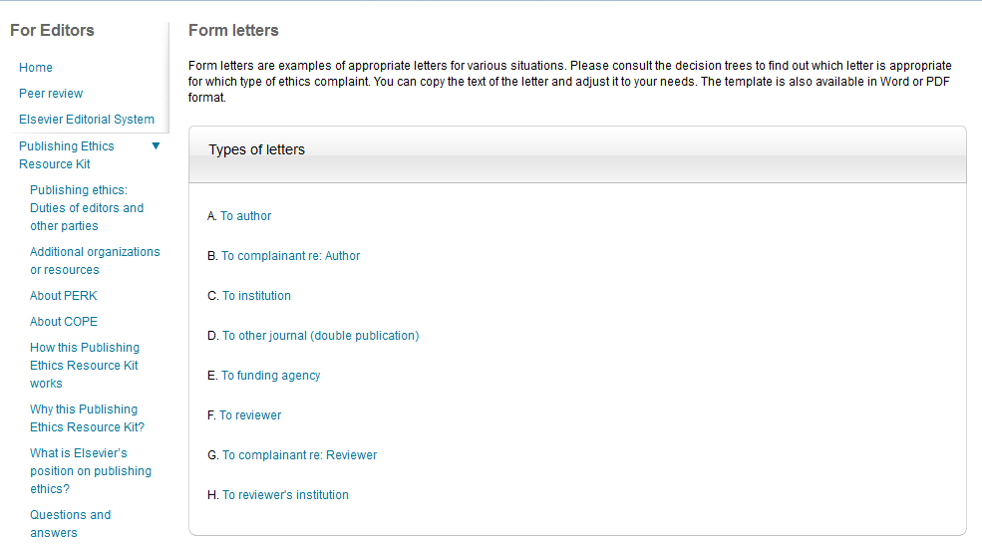
Form Letters
http://www.elsevier.com/editors/perk/form-letters

Slide 11
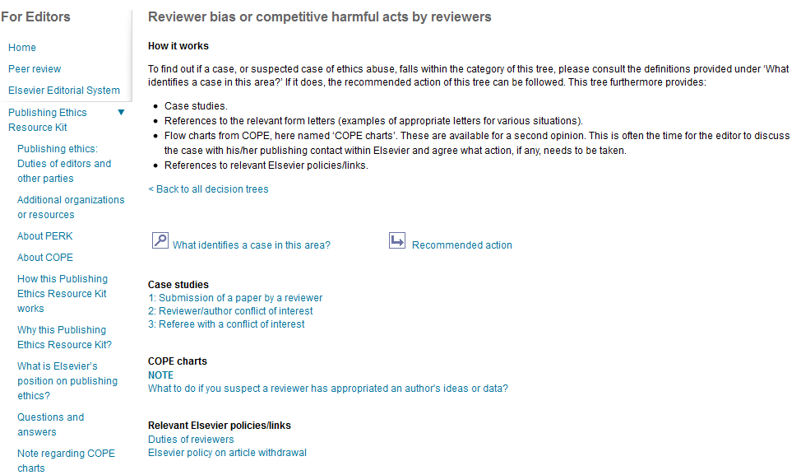
http://www.elsevier.com/editors/perk/reviewer-bias-or-competitive-harmful-acts-by-reviewers

Slide 12
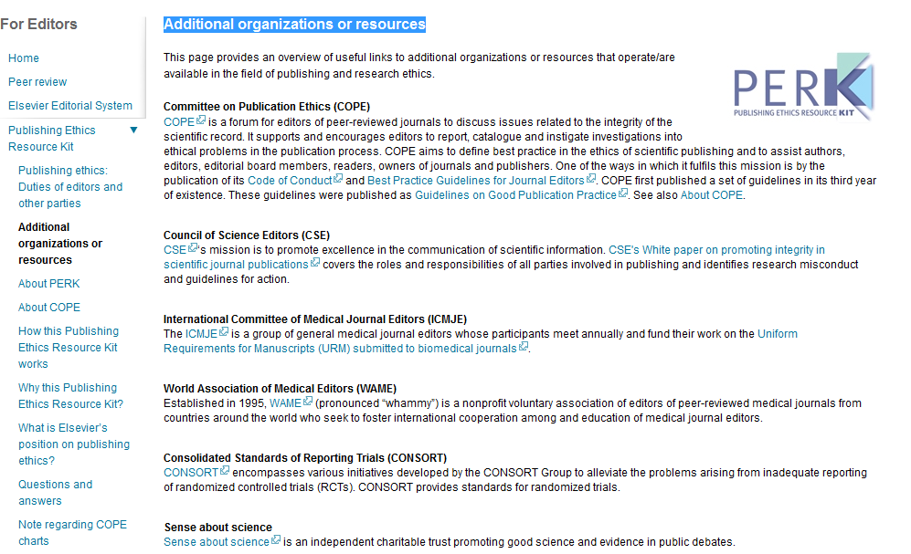
Additional Organizations or Resources
http://www.elsevier.com/editors/perk/additional-organizations-or-resources

